Slide 1


Slide 2


COVID 19 GLOBAL LIVE UPDATES
USCBC

Slide 3

Covid 19
by Paola Moreno, Estela Perez, Osamu Adler, Ramiro Cervantes
This Photo by Unknown Author is licensed under CC BY-NC

Slide 4
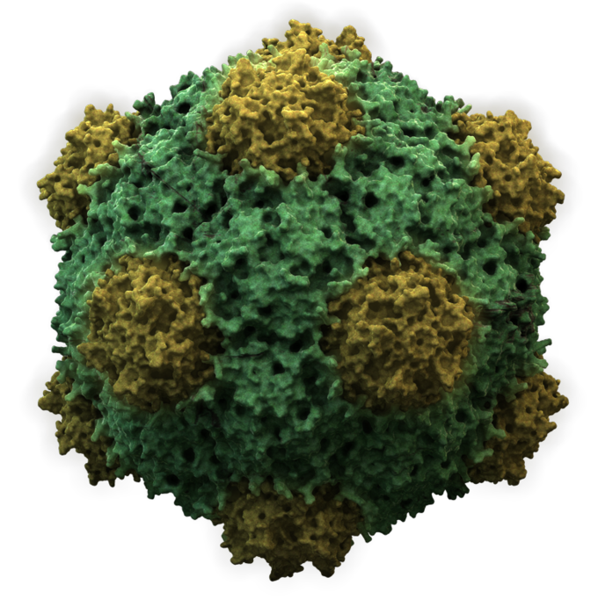
Summary-Covid-19 Analysis (Confirmed Cases and Deaths)
The purpose of our COVID-19 analysis is to illustrate the cases and death rate across global regions as well as to identify the largest countries with cases, infections, and death rate.
This Photo by Unknown Author is licensed under CC BY-SA

Slide 5
SQL

Slide 6
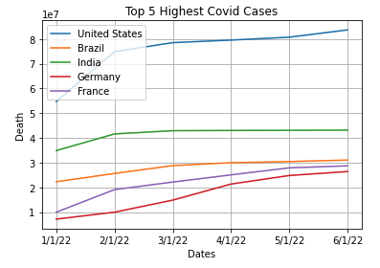
Top 5 Highest Covid Cases
Through our data collection we were able to track the 5 highest infected countries with the United States, Brazil, India, Germany, and France taking the top 5 spots.

Slide 7
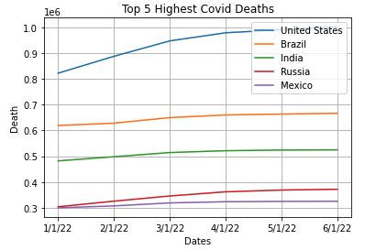
Top 5 Highest Covid Deaths
This graph can be compared alongside the infection graph to help illustrate the relationship between infection and death.

Slide 8
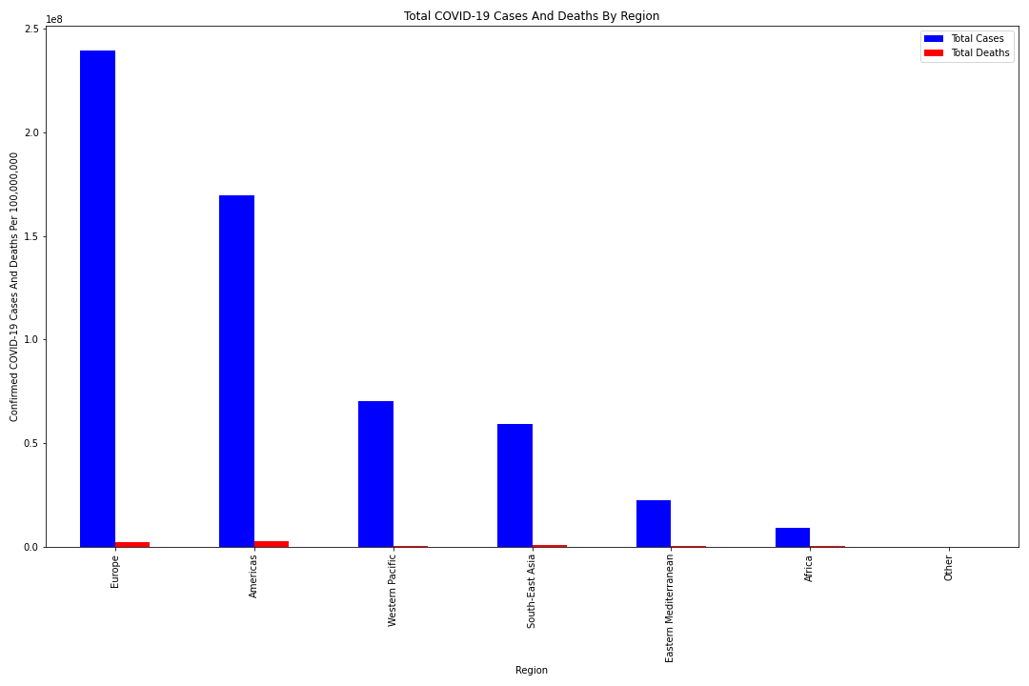
Cases and Deaths By Region
This graph puts together the 5 biggest global regions.

Slide 9
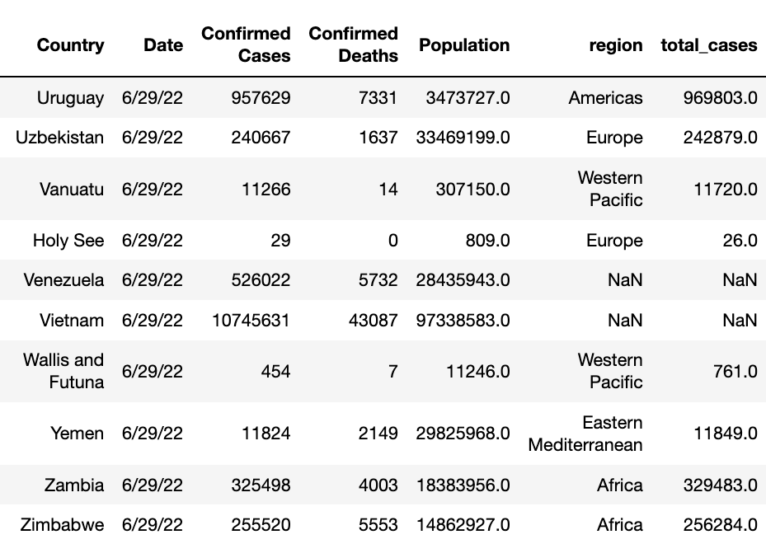
Data Sample

Slide 10
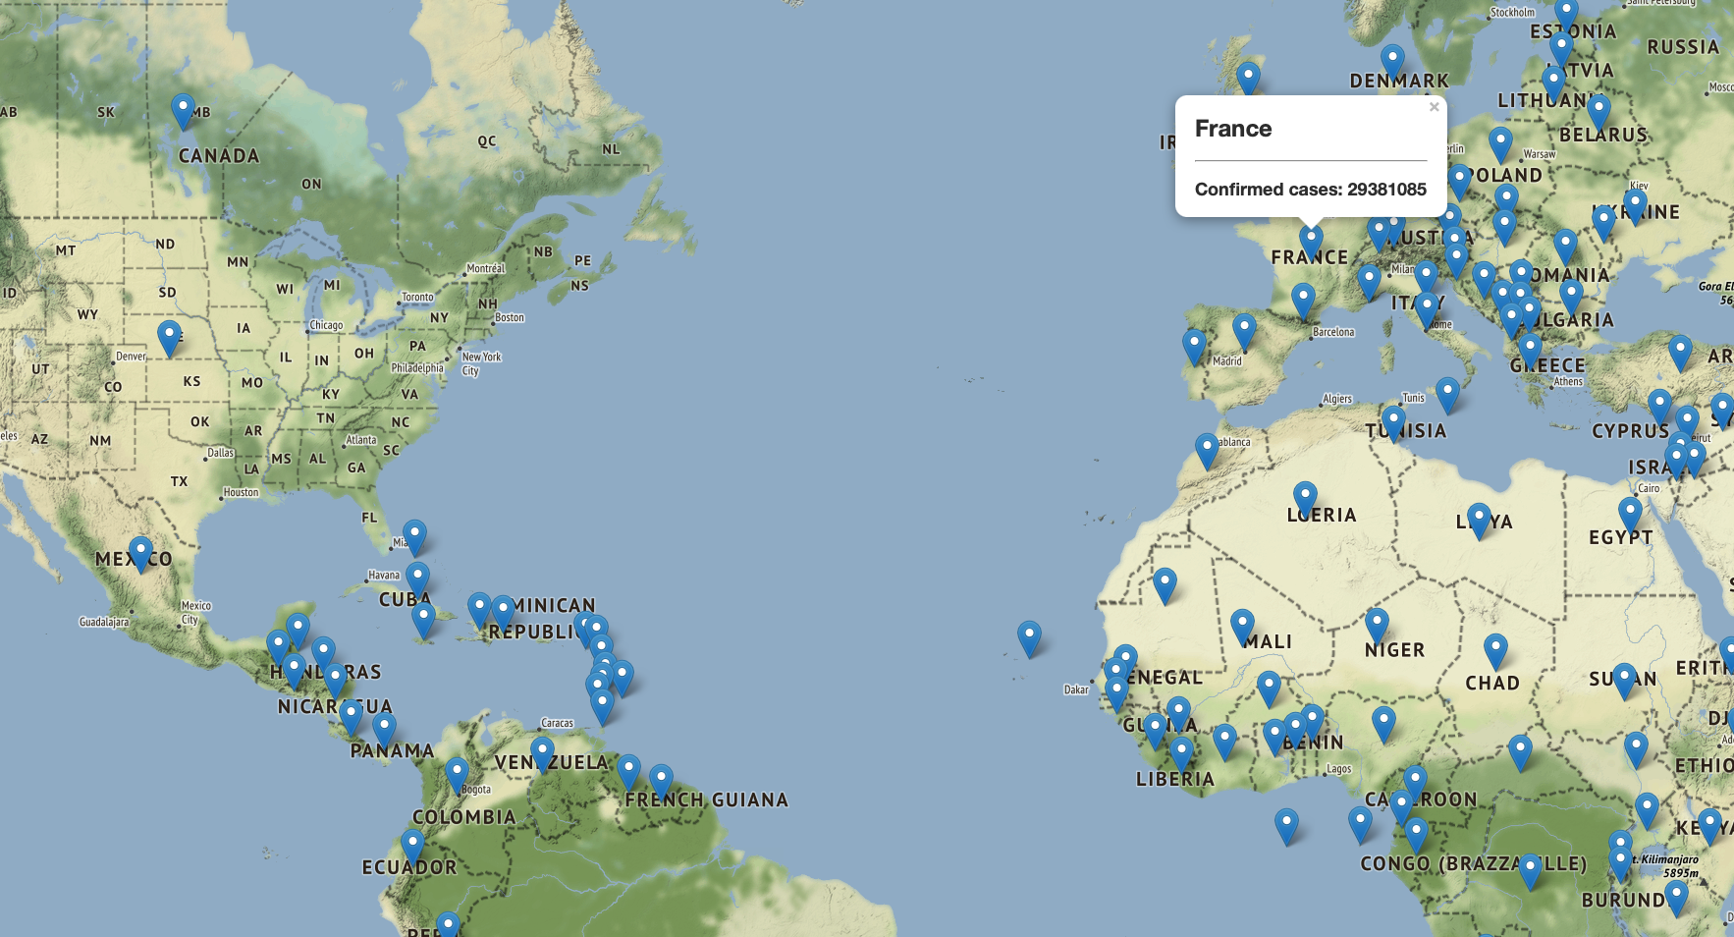
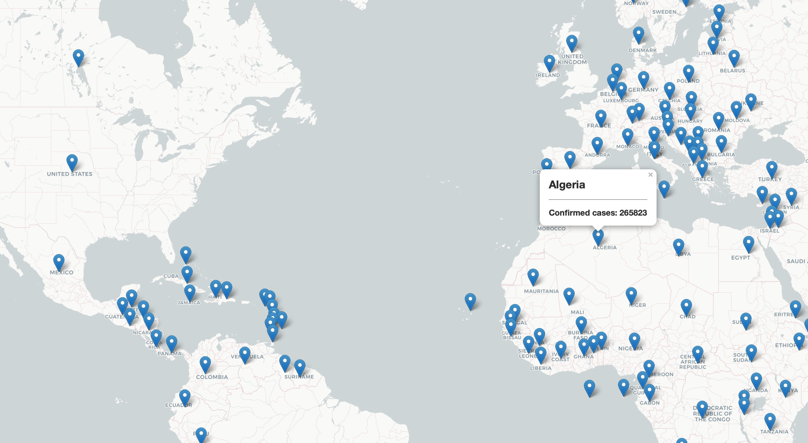
World Map Preview
Confirmed Cases 05/16/2022

Slide 11

Web Tour
https://paozmoreno.github.io/Project_3/
file:///Users/ramirocervantes/Downloads/index (20).html

Slide 12
Data Sources
U.S. Census Bureau (for country population)
https://www.census.gov/data-tools/demo/idb/#/table?COUNTRY_YEAR=2022&COUNTRY_YR_ANIM=2022&ANIM_PARAMS=2019,2022,3&menu=tableViz&TABLE_RANGE=2019,2022&TABLE_YEARS=2019,2020,2021,2022&TABLE_USE_RANGE=Y&TABLE_USE_YEARS=Y&TABLE_STEP=1&TABLE_ADD_YEARS=2022
World Health Organization
https://covid19.who.int/data
https://covid19.who.int/table
State COVID-19 Data and Policy Actions
https://www.kff.org/coronavirus-covid-19/issue-brief/state-covid-19-data-and-policy-actions/

Slide 13

Limitations
Time Frame
Organization
New JS Library (interactive Map)

Slide 14

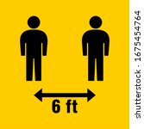
For questions and concerns please contact USCBC Network.
Please be advised that if questions are not asked with 6’ of distance they will not be answered.
Thank you
This Photo by Unknown Author is licensed under CC BY-SA

